Slide 1
Assignment-1: POS Tagging
Aditya Sharma 170050043
Yash Jain 170050055
Debabrata Mandal 170050073

Slide 2
Comparison of Performance across the three methods

Slide 3
Performance comparison
Method | Test Accuracy
SVM | 83.5%
HMM | 96.57%
Bi-LSTM | 97.00%

Slide 4
HMM - Hidden Markov Model

Slide 5
Performance for 5-fold cross validation
 | Accuracy
1st fold | 95.94 %
2nd fold | 96.87 %
3rd fold | 96.55 %
4th fold | 96.43 %
5th fold | 97.06 %
Avg accuracy | 96.57 %

Slide 6
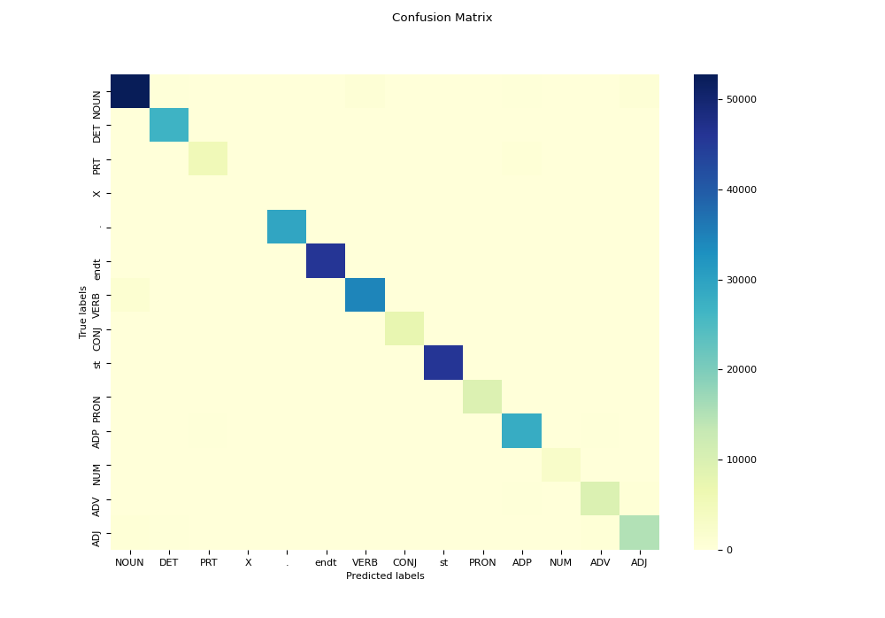
Confusion Matrix

Slide 7
Per-pos accuracy
DET | 98.68 %
VERB | 95.13 %
NOUN | 95.29 %
ADP | 96.58 %
NUM | 91.81 %
. | 99.89 %
PRT | 90.31 %
X | 57.18 %
ADV | 89.53 %
PRON | 98.37 %
ADJ | 91.79%
CONJ | 99.48%
The per-pos accuracy was calculated for the last cross validation fold.
ADV -> ADJ(~5%) + ADP(~3.6%) + PRT(~1.6%)
ADJ -> NOUN(~3.5%) + ADV(~3%) + DET(~2%)
NUM -> NOUN(~7%)
PRT -> ADP(~10%)

Slide 8
Strengths and Weakness
The learning algorithm is efficient. Decoding is also efficient -> Complexity: O(n²L)
Faster training as compared to SVM and Bi-LSTM.
No need for feature engineering because we don’t have to design features.
Very less parameters as compared to SVM.
HMM assumes Markov condition holds, which may not always be true. Therefore this is limited by first order markov property.
The effect of far off terms on is not considered while deciding the tags for the given word.
It is sometimes difficult to tag words where the uncommon tag is shadowed by the dominant tag in Emission probabilities.(example given in following slides)

Slide 9

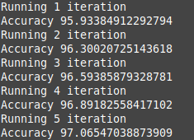
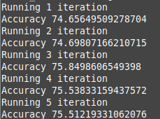
Error Analysis (1/3)
Before using any smoothing techniques, the model was giving an accuracy of around 75%. Then after using a simple Linear Interpolation technique, the accuracy jumped to 95% +. The following gives an idea about the interpolation technique used:

Slide 10
Error Analysis (2/3)
Actual Tag | Predicted Tag | Sample Sentence | Explanation
NOUN | VERB | Sentence: cap would find him and take care of him . Actual Tags: NOUN VERB VERB PRON CONJ VERB NOUN ADP PRON . Given Tags: NOUN VERB VERB PRON CONJ VERB VERB ADP PRON . | Notice here that “care” also behaves as a VERB in english and hence emission probability will be high for VERB. Also there are many instances of VERB followed by VERB for example: “he was playing”, “they were dancing”. Hence, VERB to VERB transition probability is also high.
VERB | NOUN | Sentence: there was much shouting and screaming . Actual Tags: PRT VERB ADJ NOUN CONJ NOUN . Given Tags: PRT VERB ADJ VERB CONJ VERB . | Notice that “shouting” and “screaming” also behave as continuous tense forms of the verbs and hence emission probability will be high for VERB.

Slide 11
Error Analysis (3/3)
Actual Tag | Predicted Tag | Sample Sentence | Explanation
NOUN | ADJ | Sentence: around the billiard tables were always at least a couple of dozen beribboned generals . Actual Tags: ADP DET NOUN NOUN VERB ADV ADP ADJ DET NOUN ADP NOUN ADJ NOUN . Actual Tags: ADP DET ADJ NOUN VERB ADV ADP ADJ DET NOUN ADP NOUN ADP NOUN . | This is one of the many cases where the phrase is a COMPOUND NOUN and the Model incorrectly classifies it as an ADJECTIVE followed by a Noun. This is also a problem because of high transition probabilities of ADJ to NOUN and DET to ADJ. Whenever there is a word which occurs rarely, smoothing will reduce the advantage of Emission Probability.

Slide 12
Bi-LSTM

Slide 13
Performance for 5-fold cross validation
 | Accuracy
1st fold | 96.98 %
2nd fold | 96.91 %
3rd fold | 96.99 %
4th fold | 97.07 %
5th fold | 97.03 %
Avg accuracy | 97.0 %

Slide 14
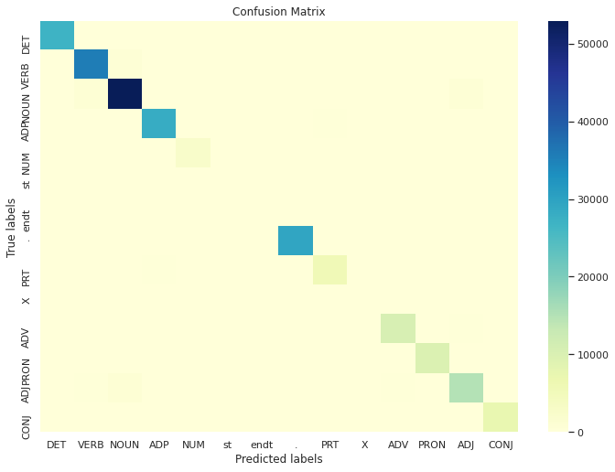
Confusion Matrix

Slide 15
Per-pos accuracy
DET | 99 %
VERB | 97 %
NOUN | 97 %
ADP | 98 %
NUM | 88 %
. | 100 %
PRT | 95 %
X | 10 %
ADV | 93%
PRON | 98 %
ADJ | 91 %
CONJ | 100 %
The per-pos accuracy was calculated for the last cross validation fold.
It can be observed that Per-POS tag accuracy varies quite a lot with tags (depends on support/data) and hence, is less robust compared to HMM or SVM

Slide 16
Model Architecture
BiLSTMNet(
(embeddings): Embedding(49817, 256)
(bilstm): LSTM(256, 256, batch_first=True, bidirectional=True)
(fc): Linear(in_features=512, out_features=14, bias=True)
(dropout): Dropout(p=0.3, inplace=False)
(softmax): Softmax(dim=2)
)
where, (49817, 256) = dictionary of word index to embeddings

Slide 17
Strengths and Weakness
Achieved the highest accuracy among the other methods
Does not require any type of feature engineering, model handles everything on its own
Method is able to utilise the context of far-off words from both sides of the sentence giving better POS tagging
Slowest in training compared to other methods
Does not have a good explainability of the reason behind performance compared to other methods
Hidden dimension of Bi-LSTM: Tuning this hyperparameter showed us the fragility of our system. For eg. when kept to 64: the average accuracy was 95% but the accuracy of POS-tag ‘X’ was 0%. While when increased to 256, the same numbers were 97% and 10% respectively.
High variance in per-POS accuracy compared to others

Slide 18
Error Analysis (1/2)
To+infinitive: In English language, the word “to” can be followed by either a VERB or a NOUN depending on its use as a preposition or adposition. But the Bi-LSTM seems to have been biased in predicting the word followed by “to” as VERB always. Here are some examples to bolster the hypothesis.
Eg. From the fusty panaceas of spinach, eggs and prunes. The US has progressed to curds, concentrates and capsules.
Actual tags: ADP DET ADJ NOUN ADP NOUN . NOUN CONJ NOUN . DET NOUN VERB VERB ADP NOUN . NOUN CONJ NOUN
Predicted tags: ADP DET NOUN NOUN ADP NOUN . NOUN CONJ VERB . DET NOUN VERB VERB PRT VERB . NOUN CONJ NOUN
Much to Damon Runyon’s amazement, as well as my own. I got along splendidly with hetman.
Actual tags: ADJ ADP NOUN NOUN NOUN …
Predicted tags: ADJ ADP VERB ADJ NOUN …

Slide 19
Error Analysis (2/2)
ADJ vs NOUN: In longer sentences, it has been observed that NOUN is often tagged as ADJ, increasing the number of false negatives of ADJ and thereby its per-pos accuracy.
Eg. A coat of paste wax or a rubdown with a piece of wax paper will protect the polished surface of the table.
Actual tags: DET NOUN ADP NOUN NOUN CONJ DET NOUN ADP DET NOUN ADP NOUN NOUN VERB VERB DET VERB NOUN ADP DET NOUN .
Predicted tags: DET NOUN ADP NOUN NOUN CONJ DET ADJ ADP DET NOUN ADP NOUN NOUN VERB VERB DET VERB NOUN ADP DET NOUN .
The private detective is militant against injustice, a humorous and ironic explorer of the underworld.
Actual tags: DET ADJ NOUN VERB NOUN ADP NOUN . DET ADJ CONJ ADJ NOUN ADP DET NOUN .
Predicted tags: DET ADJ NOUN VERB ADJ ADP NOUN . DET ADJ CONJ ADJ NOUN ADP DET NOUN .

Slide 20
SVM

Slide 21
Feature Vector
We used the following properties to construct the feature vectors from words to train the SVM model:
prev-prev-tag
prev-tag
is_first
is_last
is_capitalized
are_all_capitalized
are_capitals_inside
is_numeric
prefix-1
prefix-2
suffix-1
suffix-2
prev-word embedding (from word2vec)
prev-prev-word embedding
this-word embedding
next-word embedding
Word embeddings have been obtained using word2vec from the library gensim.
Each word approximates to a feature vector of around size 100.

Slide 22
Converting features to one-hot encoding
To convert the feature vectors to their one-hot form, for training, we made use of the DictVectorizer available from sklearn.
The input to DictVectorizer is all the features except the word embeddings.
The output from DictVectorizer and the word embeddings (for the four neighbourhood words) are appended together to form the final feature vector.
Final feature vector size ~ 786

Slide 23
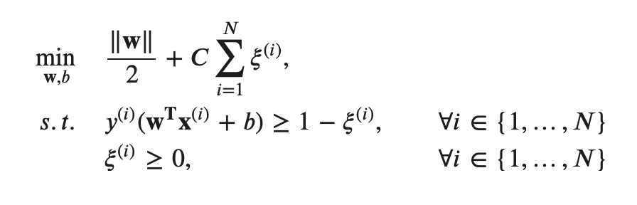
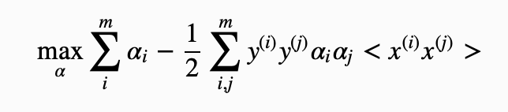
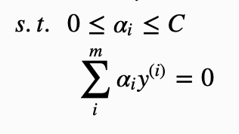
Optimization problem for SVM
Solve the dual version of the SVM soft-margin problem.
By
Duality

Slide 24
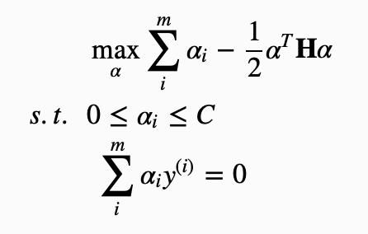

Optimization problem for SVM (contd)
Convert the dual version to a form that is solvable by using cvxopt library.

Slide 25
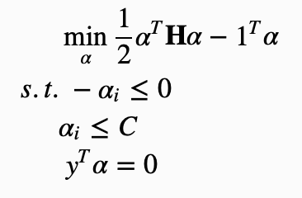
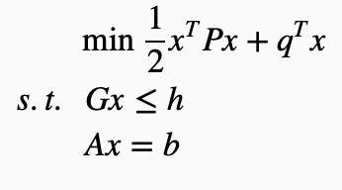
Optimization problem for SVM (contd)
Use w and b to predict signs (and hence tags) of the new test words
Input to cvxopt to solve and output α
Derive w and b from α

Slide 26
Classification
Used one vs rest classification to predict tags for input words.
For each, tag trained a one vs rest classifier
Extracted the tag predictions on each test word from the classifiers
Used numpy argmax to get the max prediction tag from the list of predictions
To get better accuracy, used the margin predicted for each word by each tag classifier as a measure of the word having that tag.

Slide 27
Performance for 5-fold cross validation
 | Our training accuracy | Our test accuracy | sklearn’s SVC training accuracy | sklearn’s SVC test accuracy
1st fold | 99.95 % | 83.05 % | 98.96 % | 86.52 %
2nd fold | 98.64 % | 84.82 % | 98.75 % | 86.29 %
3rd fold | 99.61 % | 83.69 % | 98.06 % | 86.04 %
4th fold | 98.42 % | 83.87 % | 98.75 % | 86.29 %
5th fold | 99.08 % | 83.98 % | 98.01 % | 86.68 %
Avg accuracy | ~ 99 % | ~ 83.5 % | ~ 98.5 % | ~ 86 %

Slide 28
per-POS accuracy
. | 99.99 %
NOUN | 90.37 %
VERB | 96.49 %
NUM | 92.44 %
DET | 99.35 %
PRON | 99.5 %
PRT | 98.94 %
ADP | 97.93 %
X | 0 %
ADV | 97.52 %
ADJ | 92.16 %
CONJ | 99.87 %

Slide 29
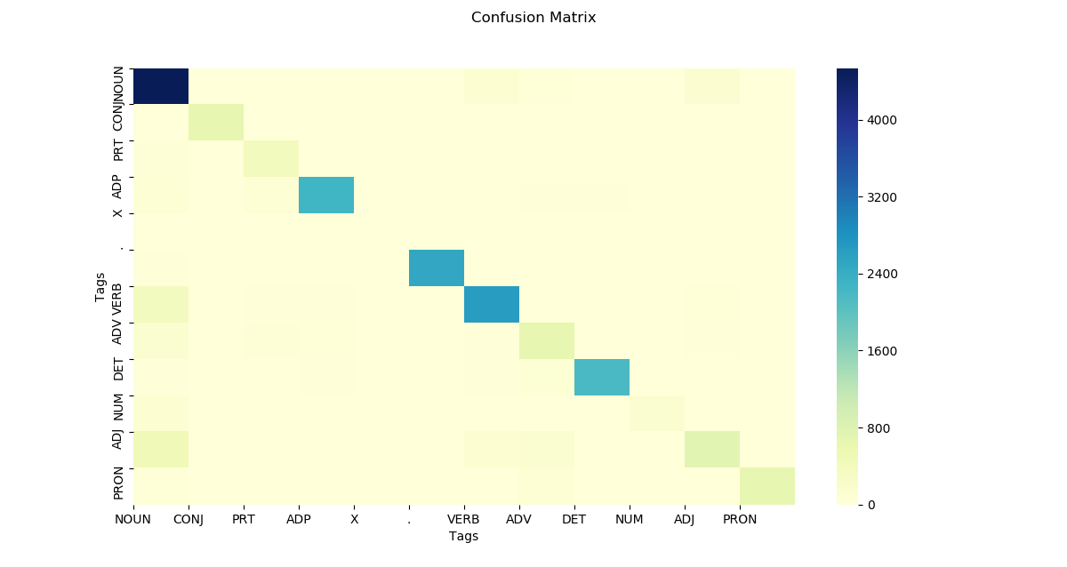

Slide 30
Error Analysis
Case 1:
For the following sentence, Noun and Adjective are mis predicted even in the presence of capitalisation. This signifies a single bit in a vector (for capitalisation) of size 768 does not successfully predict a tag.
Ex :- The_DET_DET integrity_NOUN_NOUN …. be_VERB_VERB ,_._. as_ADP_ADP the_DET_DET Charter_NOUN_ADJ puts_VERB_VERB …
Case 2:
Maximum discrepancy happens with the pairs (NOUN, ADJ) & (NOUN, VERB). (Visualised on an output of 400 predictions with 14 (NOUN, VERB) mismatch and 10 (NOUN, ADJ) mismatch.
Due to a linear model the separation between NOUN and VERB is not properly learnt.

Slide 31
Strengths
Strengths of using SVMs for POS tagging:
Since we are using Linear SVM for POS tagging, the feature vectors need to be quite robust in order for the algorithm to converge under relatively tight margin bounds.
Thus for training feature vectors of size approx 450-500, usually suffices to get an average accuracy above 80%. The strengths with this method lies in the fact that if the feature vectors are not correct (i.e. incorrectly chose features) then the accuracy will be very low. But if features are chosen properly then even a small subset (approx 200 sentences) will result in an accuracy of above 80% on a test dataset of 10000 sentences.
This is quite useful since for languages for which a large corpus is not available. SVMs show just capturing the essential features from the language will give quite good results.
Further for small datasets where the vocabulary size is small feature vector construction using a one-hot like scheme could result in far better performance due to the better separation (hence easier to find the hyperplane) in higher dimensions.

Slide 32
Weakness
Weakness witnessed for SVM for POS tagging:
One primary weakness of using Linear SVM for POS tagging lies in the fact that if we are unable to design the feature vectors correctly the impact of this on the algorithm could be huge since it tries to classify data using a hyperplane (which can be relaxed to some extent by using a soft margin classifier or using kernels).
Another weakness is the time required to train the model. Since we are solving a quadratic optimization problem here, scaling with an increasing number of examples for training is not feasible due to the fact with more examples the size of the feature vector increases (faster when using one hot encoding). This puts a constraint on the size of the dataset to be trained upon.
(There are alternatives like using kernels or solving the quadratic optimization problem by using an algorithm called SMO which solves the dual version of the problem, allowing for kernels also, but we left it due to its complicated implementation.)
To train 2000 examples, we need to solve an optimization problem involving a 2000x2000 matrix with each vector and that too for each tag individually since it is a multi classification problem.
This makes the training too time consuming for this model.

